Slide 1



Ataman Consulting Ltd
Data Analysis & Insights
ABC Wholesale Company
Onur Ataman

Slide 2
Introduction
An online retail store has hired me as a consultant to review their data and provide insights that would be valuable to the CEO and CMO of the business. The business has been performing well and the management wants to analyse what the major contributing factors are to the revenue so they can strategically plan for next year.

Slide 3
How does data add value to organisations?
The leadership is interested in viewing the metrics from both an operations and marketing perspective. Management also intends to expand the business and is interested in seeking guidance into areas that are performing well so they can keep a clear focus on what’s working. They would also like to view different metrics based on the demographic information that is available in the data.
This data analysis project is going to support C-Level managers in their next year strategies.

Slide 4
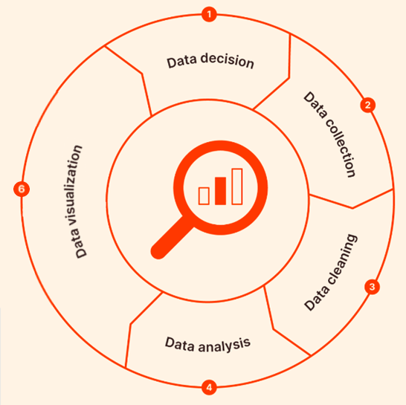
Project Process Map
This Project includes 5 sections and conclusion chapter.
You can find all of the related information under these sections.
Data Decision
Data Collection
Data Cleaning
Data Analysis & Manipulation
Data Visualization

Slide 5
1. DATA DECISION
Data Decision: Expectations of C-Levels are taken. After receiving data file, pre-analysis completed to understand which analysis can be done. Four focus questions are created to diagnose last year performance and predict the next year strategies.
Technology & Tools
Excel Pıvot Table
Soft Skills
Management Practices

Slide 6
1. DATA DECISION – Focus Questions CEO
How we perform last year? (Total sold products, revenue, total clients…)
Which countries have shown the highest sale performance?
Which stock codes or products have contributed the most to revenue?
Details of repating customers?

Slide 7
1. DATA DECISION – Focus Questions CMO
Can we identify any seasonal trends or patterns in customer demand based on the available data?
Are there any specific products that have performed exceptionally well?
How does the customer distribution vary across different countries? Which countries have the highest number of customers in the dataset?
How many customers bought from us again?

Slide 8
2. DATA COLLECTION
Data Collection: Last year sales (01.12.2010 – 09.12.2011) data file was taken in xlsx format. This data file contains following headers and 541.910 lines:
InvoiceNo
StockCode
Description
Quantity
InvoiceDate
UnitPrice
CustomerID
Country
Technology & Tools
Excel
Available from: Daqing Chen, Sai Liang Sain, and Kun Guo, Data mining for the online retail industry: A case study of RFM model-based customer segmentation using data mining, Journal of Database Marketing and Customer Strategy Management, Vol. 19, No. 3, pp. 197-208, 2012 (Published online before print: 27 August 2012. doi: 10.1057/dbm.2012.17). https://archive.ics.uci.edu/ml/citation_policy.html

Slide 9
3. DATA CLEANING
Data Cleaning: Received data file changed to excel data table. Used excel functions to formatting data. Pivot table is used for checking values and table headers for inconsistent data. Uploaded Google sheets for additional suggestions.
Data headers
Data formats standardisation
Cleaning of empty values
Cleaning quantities below 1
Cleaning unit prices below 1
Defining outliers for meaningful visuals
Trimming whitespace
Human checking for accuracy
Technology & Tools
Excel
Excel Power Query
Excel Pıvot Table
Excel Functions
Excel VBA
Google Sheets – Cleanup Suggestions
SQL Functions (TRIM..)
Power BI Destop

Slide 10
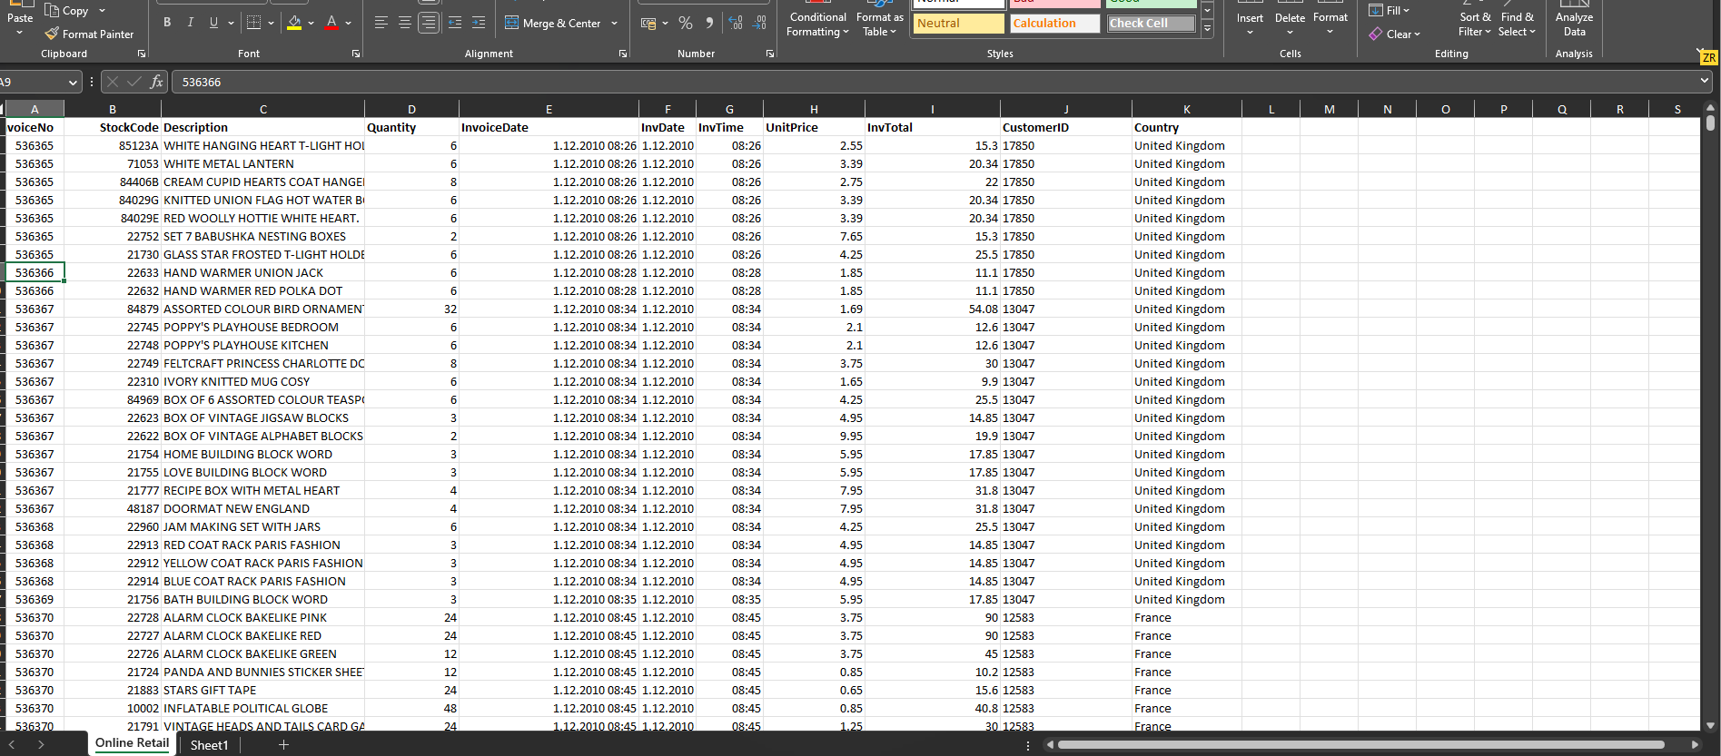
3. DATA CLEANING

Slide 11
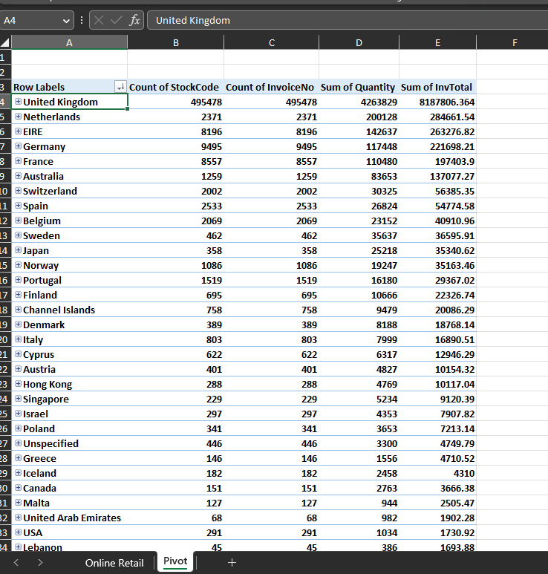
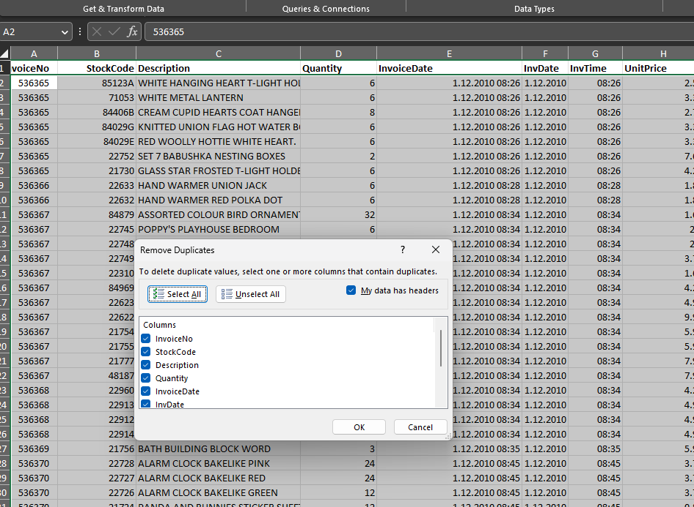
3. DATA CLEANING

Slide 12
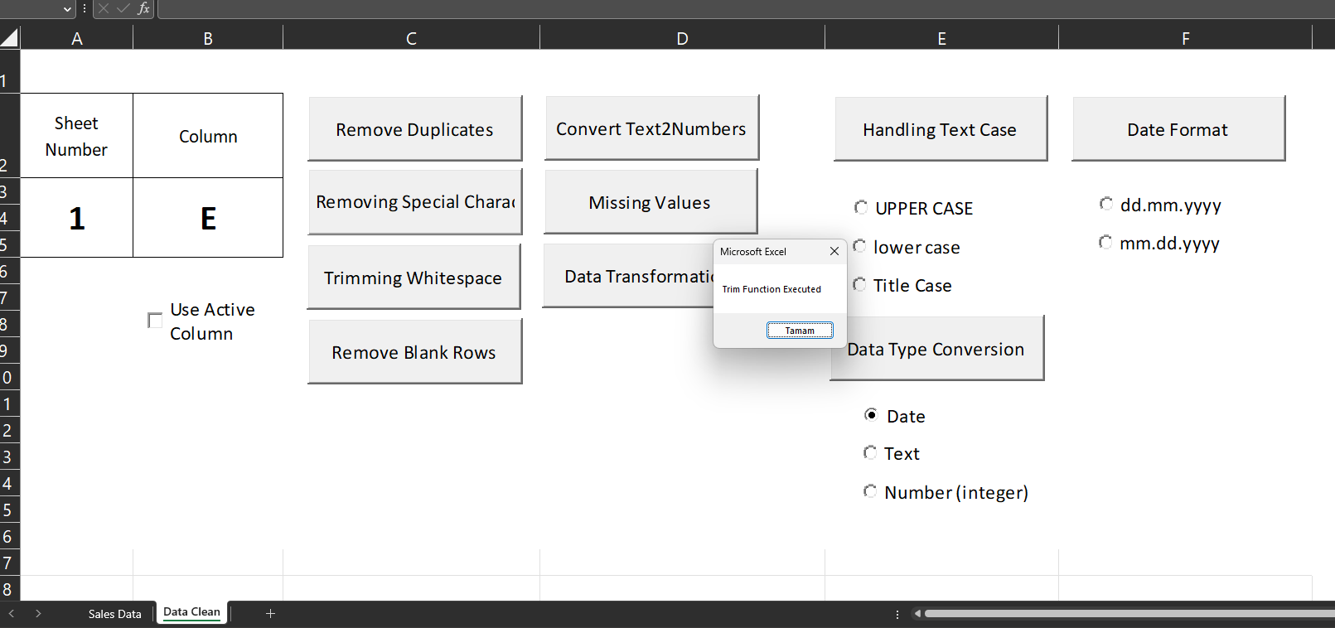
3. DATA CLEANING
Excel App
Developed for data cleaning in excel
Trim
Remove Duplicates
Missing values are used

Slide 13
3. DATA CLEANING
TRIM:
Used to remove leading and trailing spaces from a string.
Example: SELECT TRIM(column_name) FROM table_name;
UPPER and LOWER:
UPPER converts a string to uppercase, while LOWER converts it to lowercase.
Example: SELECT UPPER(column_name) FROM table_name;
SUBSTRING:
Extracts a substring from a string based on specified starting position and length.
Example: SELECT SUBSTRING(column_name, start_position, length) FROM table_name;
REPLACE:
Replaces all occurrences of a specified substring with another substring.
Example: SELECT REPLACE(column_name, 'old_value', 'new_value') FROM table_name;
COALESCE:
Returns the first non-null value from a list of expressions.
Useful for handling null values and replacing them with default values.
Example: SELECT COALESCE(column_name, 'default_value') FROM table_name;
CAST or CONVERT:
Used to convert data from one data type to another.
Example: SELECT CAST(column_name AS new_data_type) FROM table_name;
DATE functions:
SQL provides various date functions to manipulate and clean date values.
Examples: DATEPART, DATEADD, DATEDIFF, FORMAT, etc.
NULL handling functions:
ISNULL: Returns a specified value if the expression is null.
NULLIF: Compares two expressions and returns null if they are equal; otherwise, returns the first expression.
Example: SELECT ISNULL(column_name, 'default_value') FROM table_name;
Regular expressions:
Some database systems support regular expressions, which can be used for advanced pattern matching and data cleaning.
Examples: REGEXP_REPLACE, REGEXP_SUBSTR, REGEXP_LIKE, etc.
SQL Functions
Trim was used for practice

Slide 14
4. DATA ANALYSIS & MANIPULATION
Data Analysis & Manipulation: After completing cleaning process, I created pivot tables to understand data better. Then I choose to work with Power BI and imported xlsx file to make further analysis. I used Python with pandas module to create graphs for understanding data, colerations and outliers better. Following processes complete under this section:
Excel Pivot Tables – To understand data better
Power BI – power query editor used for pre-analysis to develop project strategy
Statistical categories developed - country, product, quantity…
Power BI – added new measures for analysis (such as revenue, client type, average calculations…)
Technology & Tools
Power BI Destop
Excel
Python

Slide 15
5. DATA VISUALISATION
Data VISUALISATION: After completing cleaning process, I created pivot tables to understand data better. Then I choose to work with Power BI and imported xlsx file to make further analysis. I used Python with pandas module to create graphs for understanding data, colerations and outliers better. Following processes complete under this section:
Excel Pivot Tables – To understand data better
Power BI – power query editor used for pre-analysis to develop project strategy
Statistical categories developed - country, product, quantity…
Power BI – added new measures for analysis (such as revenue, client type, average calculations…)
Technology & Tools
Power BI Destop

Slide 16
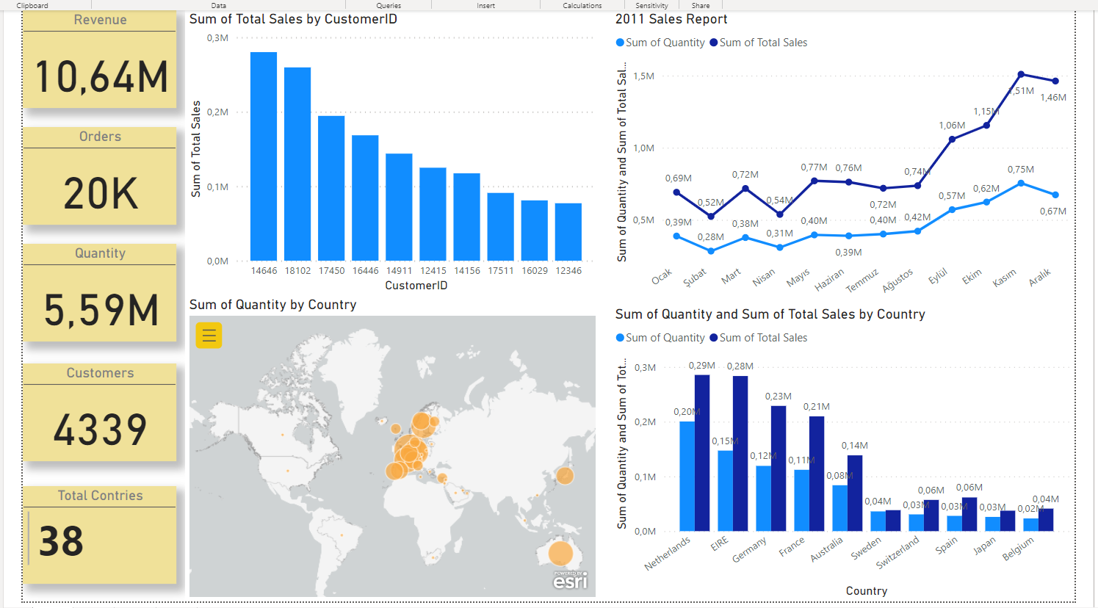
5. DATA VISUALISATION

Slide 17
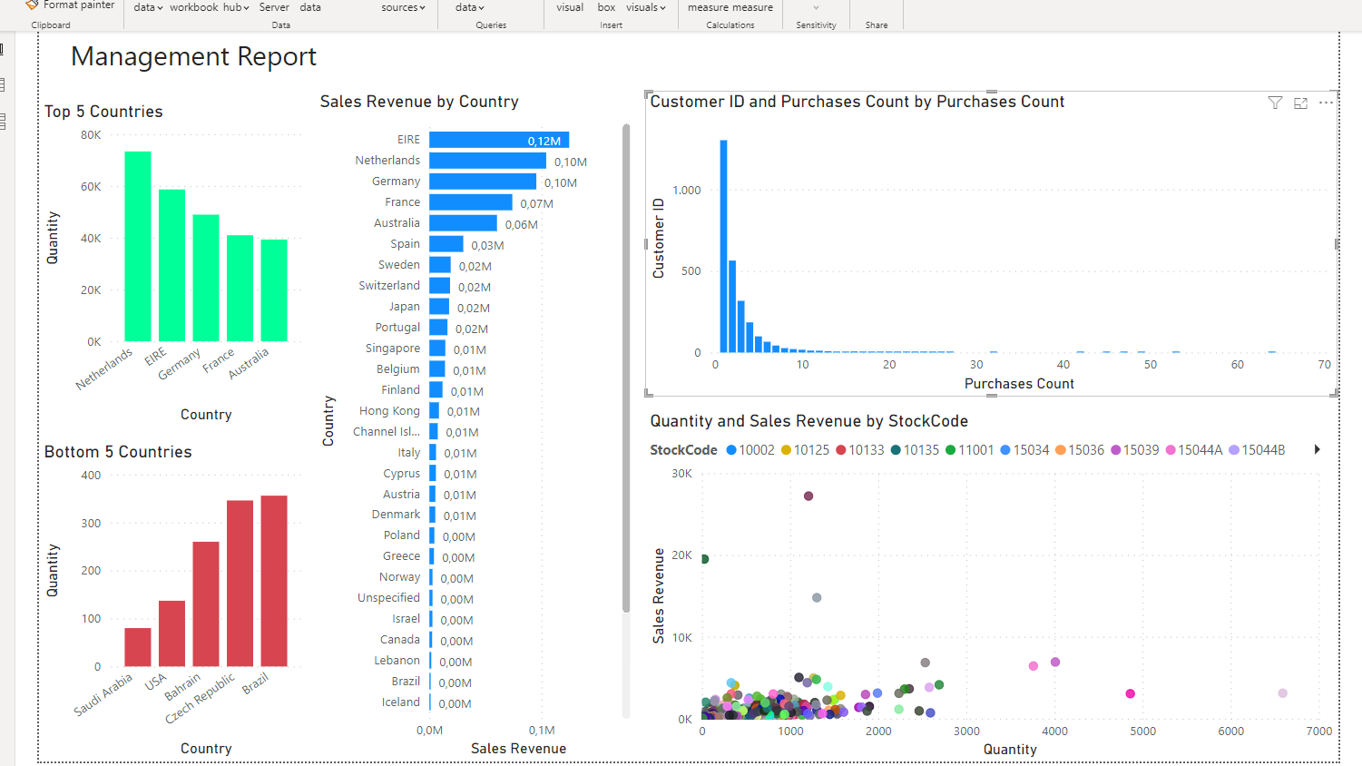
5. DATA VISUALISATION

Slide 18
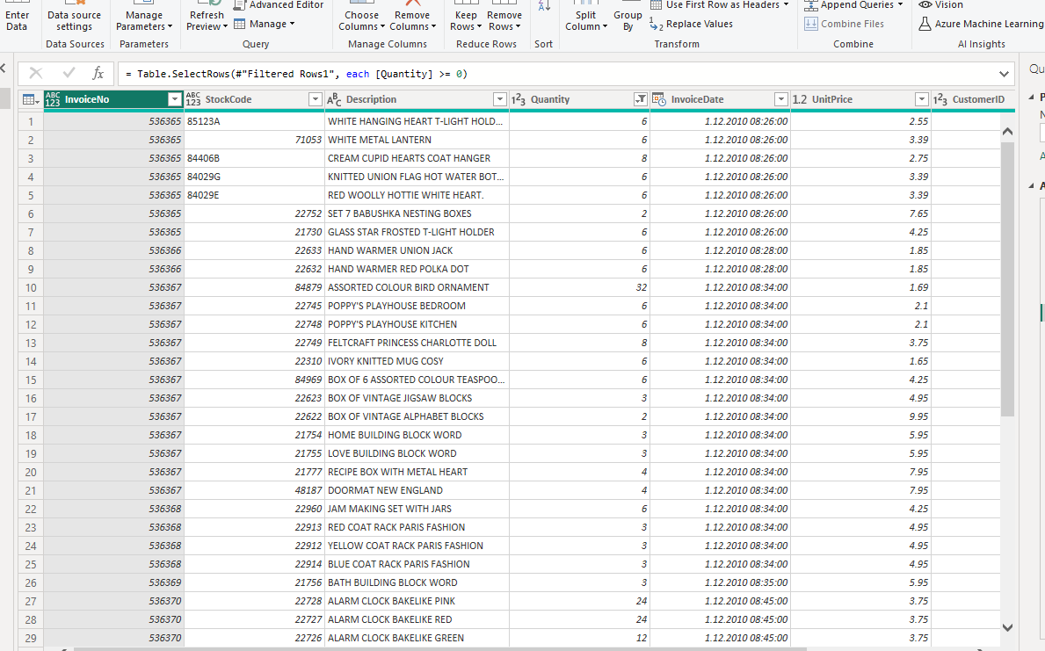
5. DATA VISUALISATION

Slide 19
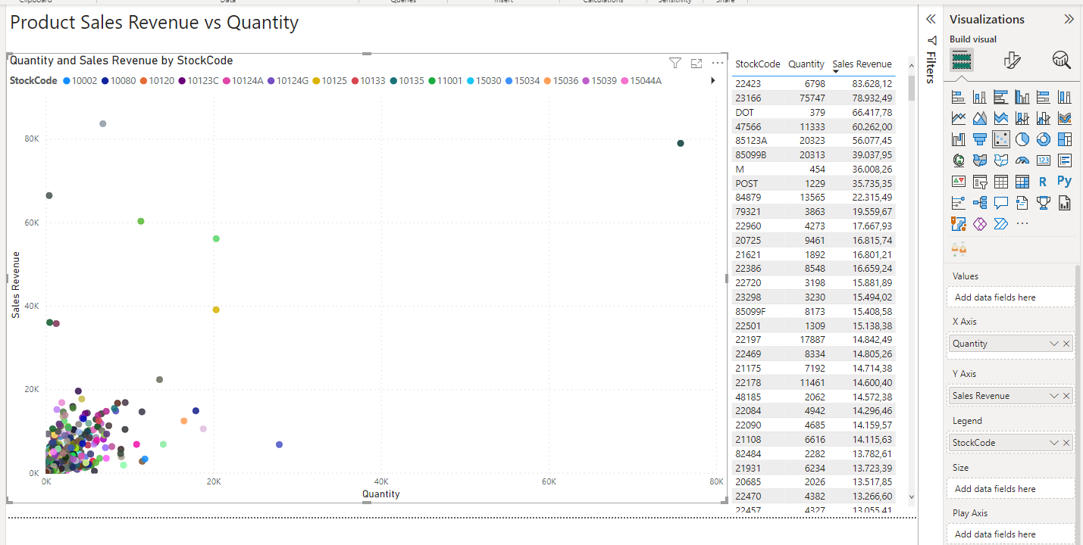
5. DATA VISUALISATION

Slide 20
CONCLUSION
The main questions are answered with this data analysis. Top Performance countries, renevue, quantity, product distributions and relational data such as month based and country based are created for this report.
There is no data for client segmentation (it should be a managerial decision such as repeating customer, quantity levels or only total revenue) but can be easily calculated and visualised under this Project.
There are no data for calculating profit levels, this can be a valuable data for deciding further strategies for focusing market expansions.
UK data is the biggest outlier so this removed from most of the analysis and graphs.

